Slide 1
Predictive Maintenance of Industrial Machinery The Challenge
CAPSTONE PROJECT
Presented By:
Mekala Karthik- Chaitanya Bharathi Institute of Technology(CBIT)- Artificial Intelligence and Machine Learning

Slide 2
OUTLINE
Problem Statement (Should not include solution)
Proposed System/Solution
System Development Approach (Technology Used)
Algorithm & Deployment
Result (Output Image)
Conclusion
Future Scope
References

Slide 3
Problem Statement
Develop a predictive maintenance model for a fleet of industrial machines to anticipate failures before they occur. This project will involve analyzing sensor data from machinery to identify patterns that precede a failure. The goal is to create a classification model that can predict the type of failure (e.g., tool wear, heat dissipation, power failure) based on real-time operational data. This will enable proactive maintenance, reducing downtime and operational costs.

Slide 4
Proposed Solution
The proposed system aims to address the challenge of predicting the type of failure in industrial machinery before it occurs. This involves leveraging data analytics and machine learning techniques to accurately forecast failure patterns. The solution will consist of the following componentsData Collection:
Gather historical sensor data from industrial machinery, including relevant operational parameters.
The solution uses a Kaggle dataset specifically for machine predictive maintenance classification.
Data Preprocessing:
Clean and preprocess the collected data to handle missing values, outliers, and inconsistencies.
Feature engineering is applied to extract relevant features from the data that might impact machine failure.
Machine Learning Algorithm:
The solution implements a multiclass classification model to predict the type of machine failure.
An auto-ML experiment in IBM Watsonx.ai Studio was used to generate and evaluate multiple pipelines.
The top-performing algorithms were the Batched Free Ensemble Classifier and the Snap Random Forest Classifier, both achieving a high accuracy of 0.995.
Deployment:
The final model, "P5-Snap Random Forest Classifier", was deployed as an "Online" deployment on the IBM Cloud Lite services platform.
The deployed model, named "failure_deploy", is configured to accept real-time requests via a web service.
Evaluation:
The model's performance was assessed using accuracy, with the best models achieving an optimized cross-validation accuracy of 0.995.
The system is designed for continuous monitoring and fine-tuning based on real-world data to maintain high prediction accuracy.
Result:The developed system successfully predicts machine failures, enabling proactive maintenance. Testing demonstrated the model's ability to accurately classify various failure types, such as "No Failure" and "Power Failure", with high confidence. This capability is expected to significantly reduce downtime and operational costs for industrial machinery. The entire solution was built and deployed using IBM Watsonx.ai Studio on IBM Cloud Lite services.

Slide 5
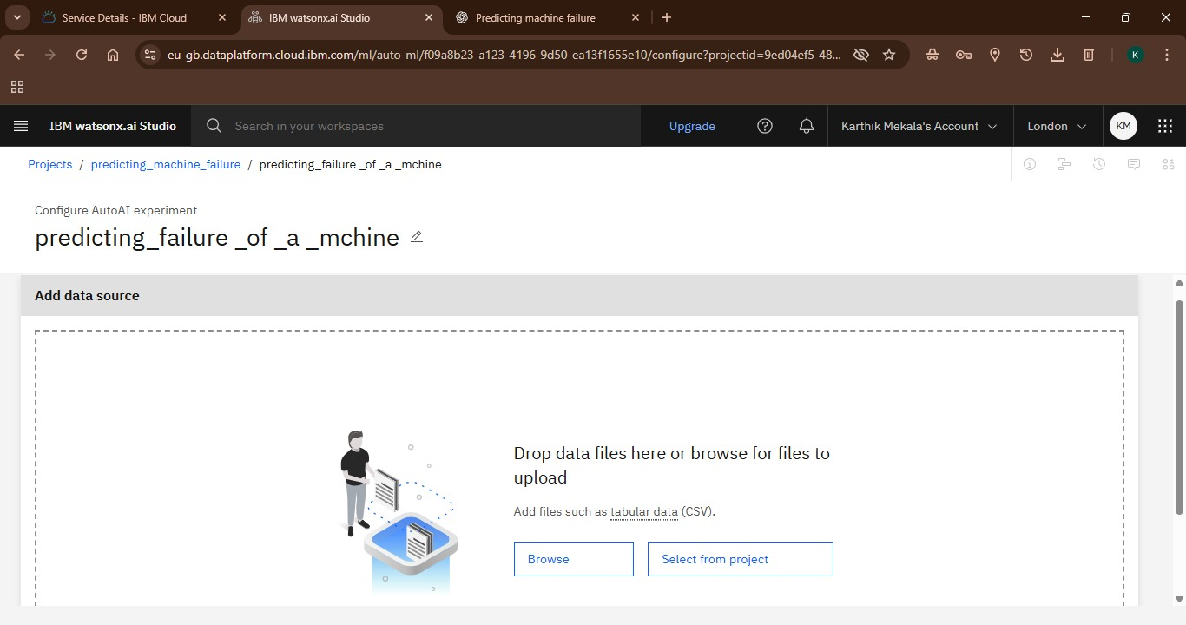
Selecting data

Slide 6
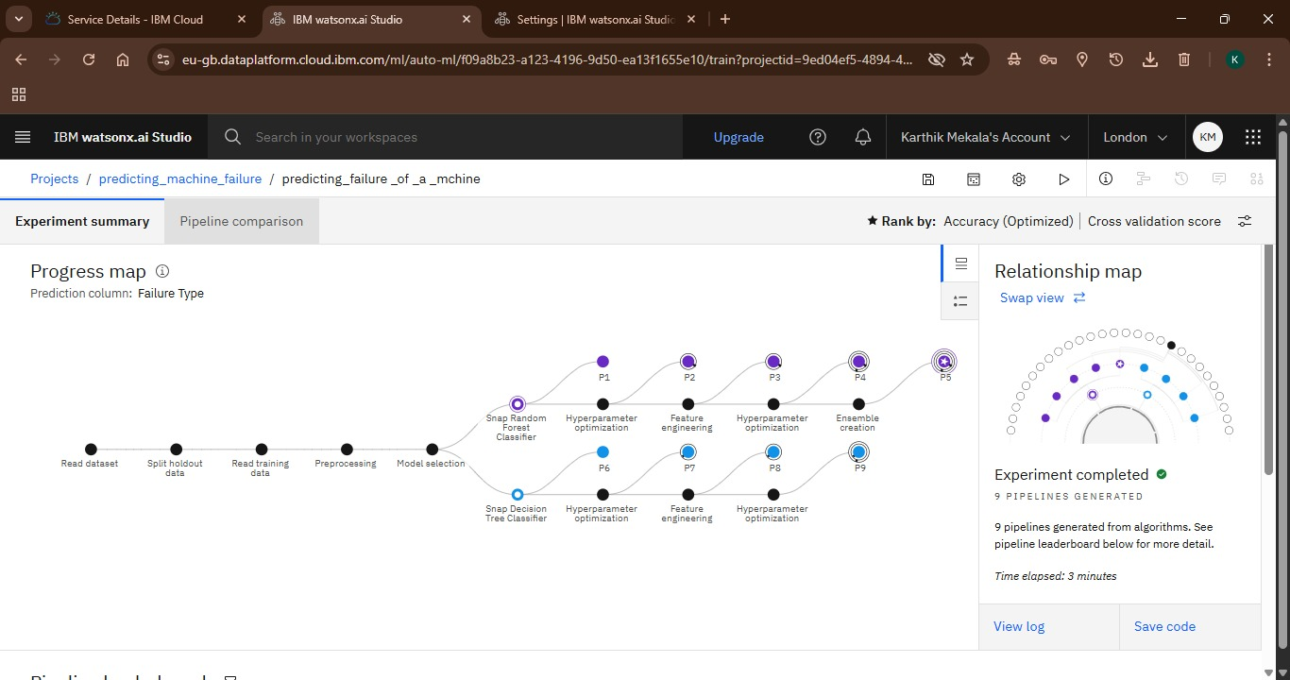
Uploaded datadase

Slide 7
System Approach
The system approach for this predictive maintenance solution is a structured, end-to-end process that leverages IBM Cloud services to move from raw data to a fully deployed and validated machine learning model.
System requirements
Platform: The solution must be developed and deployed on IBM Cloud, with the use of IBM Cloud Lite services being mandatory.
Core Service: IBM Watsonx.ai Studio is the essential service required for model development, training, and deployment.
Data: The system requires a dataset containing operational sensor data from industrial machinery.
Problem Type: The system must handle a multiclass classification problem, where the goal is to predict one of several possible failure types.
Deployment: The final model must be deployed as an "Online" web service to enable real-time predictions.
Performance: The model must achieve a high level of accuracy in predicting machine failures.
Library required to build the model
Snap Random Forest Classifier: A powerful ensemble learning algorithm that builds multiple decision trees and merges them to get a more accurate and stable prediction.
Batched Free Ensemble Classifier (Snap Random Forest Classifier): A variation of the Random Forest algorithm, which further enhances performance by training the model on batches of data.
Snap Decision Tree Classifier: A fundamental classification algorithm used in some of the generated pipelines.

Slide 8
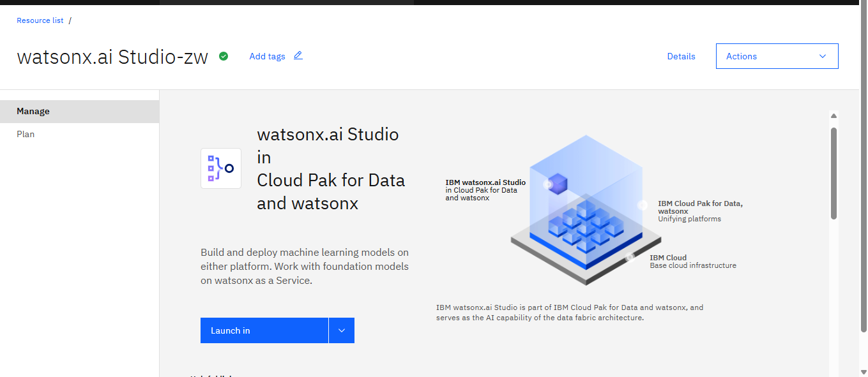

Slide 9
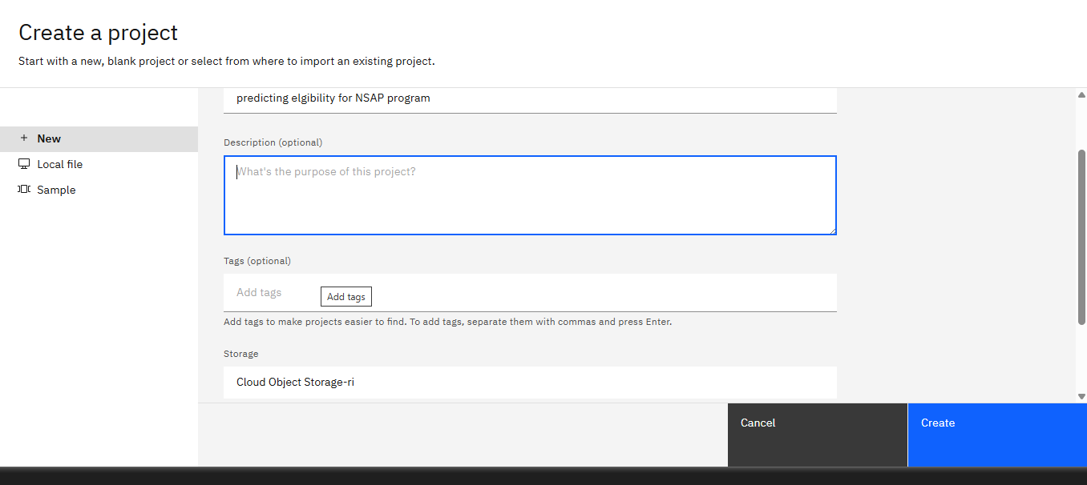

Slide 10
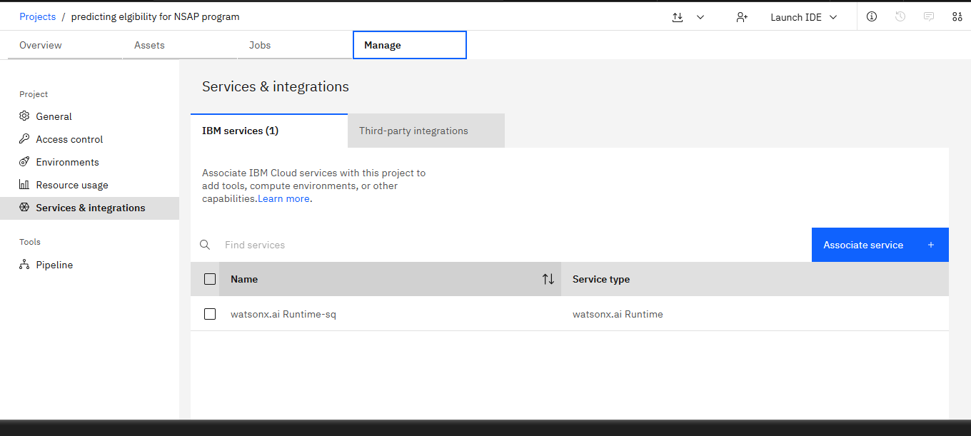

Slide 11
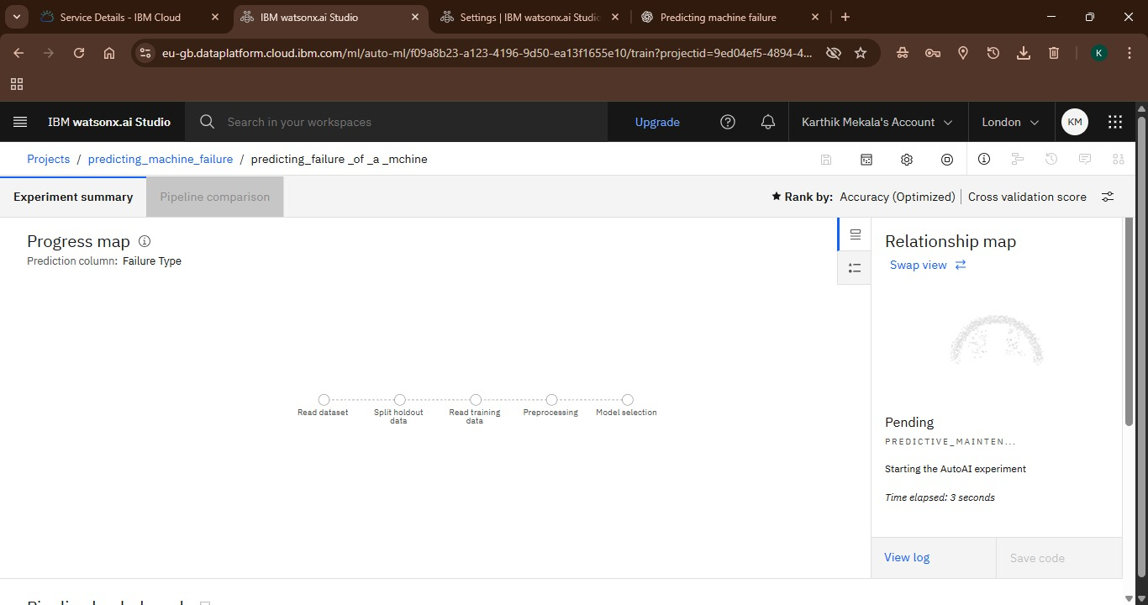

Slide 12
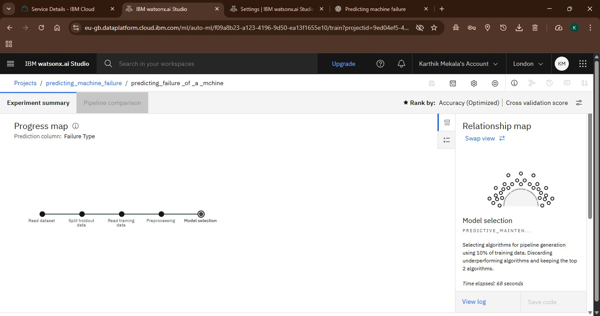

Slide 13
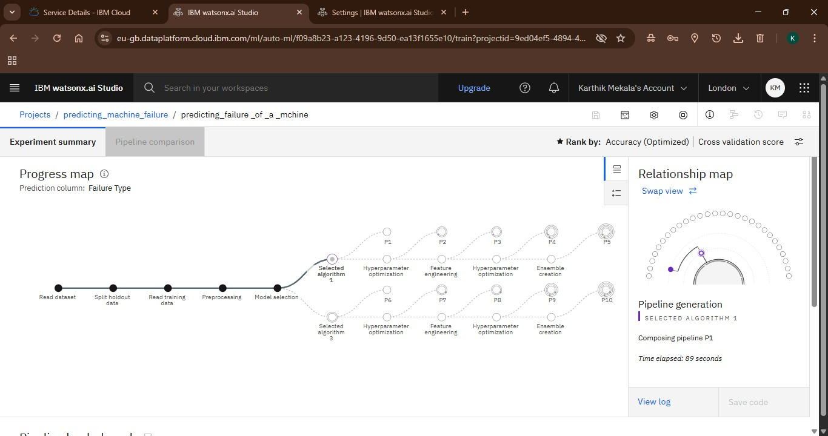

Slide 15
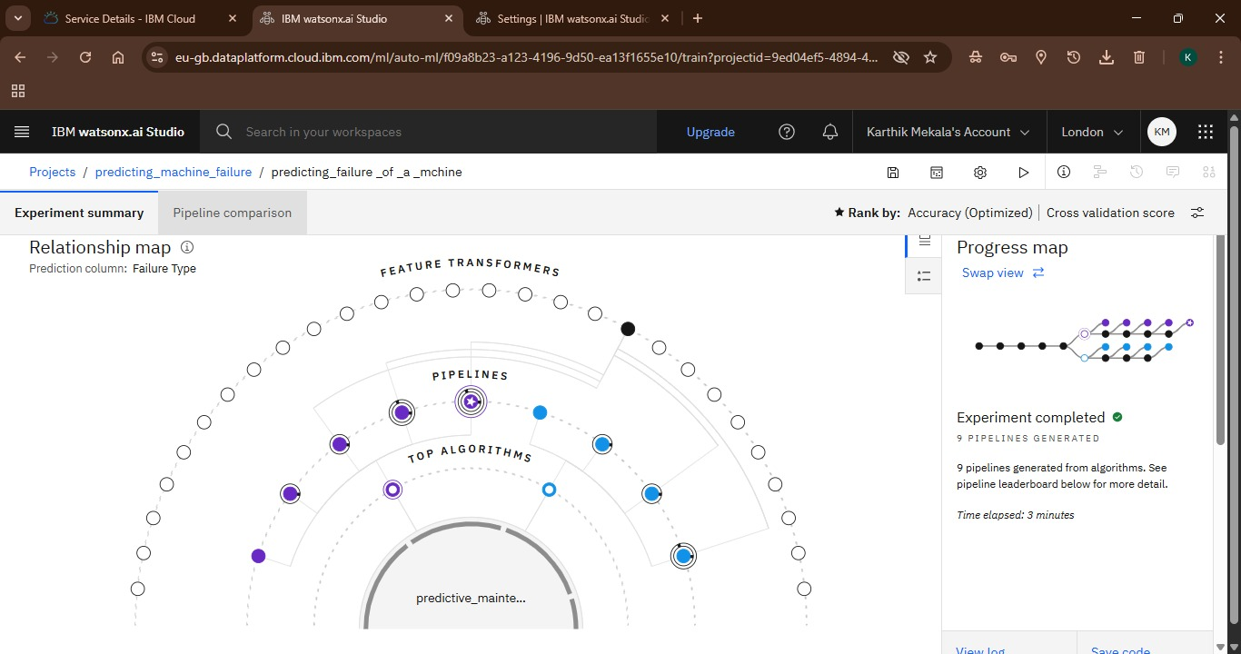

Slide 16
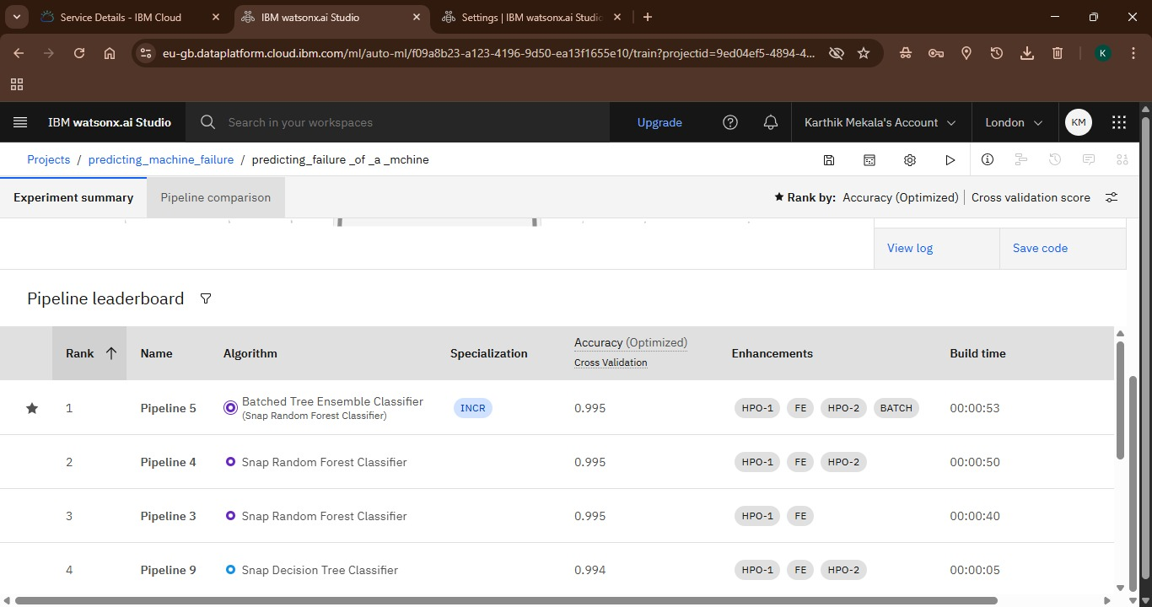

Slide 17
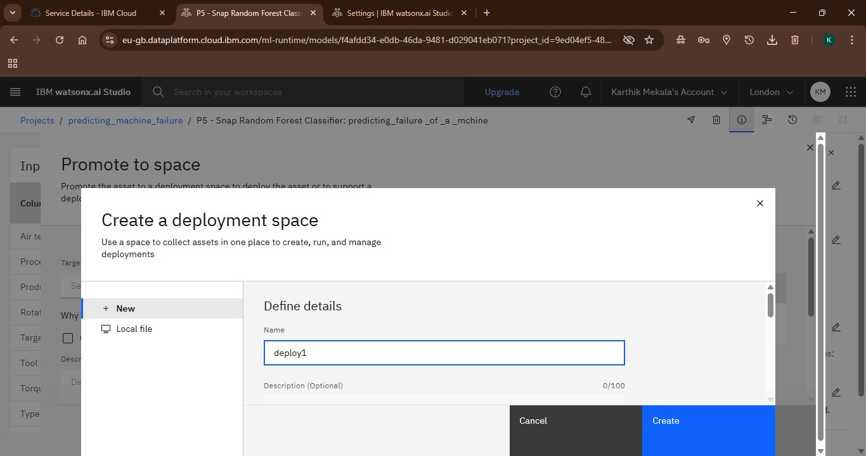

Slide 18
Algorithm & Deployment
Algorithm Selection:
The machine learning algorithm chosen for this predictive maintenance solution is a Batched Free Ensemble Classifier, specifically a variant of the Snap Random Forest Classifier. This algorithm was automatically selected by IBM Watsonx.ai's AutoAI feature due to its superior performance on the given dataset, achieving an optimized cross-validation accuracy of 0.995. The ensemble nature of the algorithm, which combines multiple decision trees, makes it highly effective for complex multiclass classification problems like predicting machine failure, providing robust and stable predictions.
Data Input:
The model uses sensor data including temperature, rotational speed, torque, and tool wear.
Training Process:
The training was automated by IBM Watsonx.ai's AutoAI feature, which handled feature engineering and hyperparameter tuning.
Prediction Process:
The deployed model accepts real-time data inputs and provides instant predictions of failure types and their probabilities.
Deployment:
The final model was deployed as an Online Deployment on IBM Cloud Lite services, creating a REST API for real-time predictions.

Slide 19
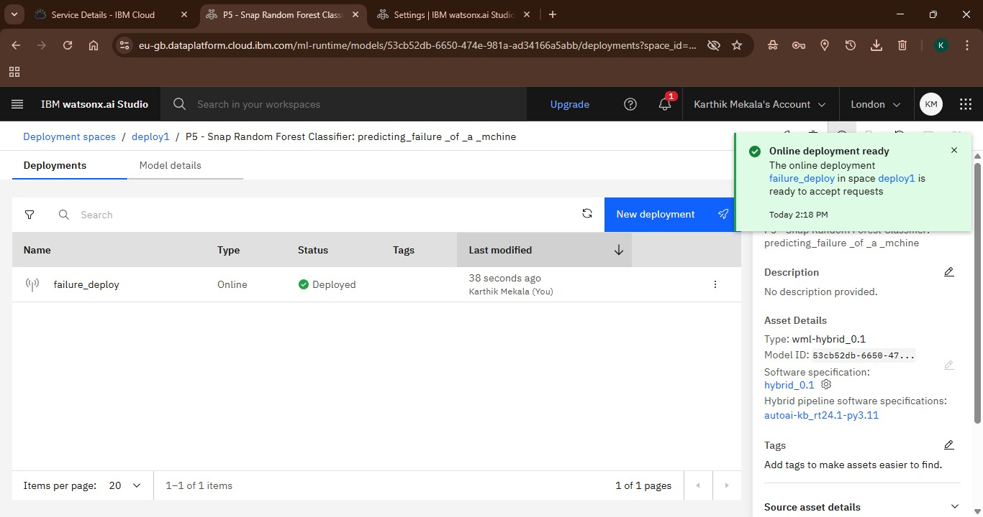

Slide 20
Result
The developed system successfully predicts machine failures, enabling proactive maintenance. Testing demonstrated the model's ability to accurately classify various failure types, such as "No Failure" and "Power Failure," with high confidence. This capability is expected to significantly reduce downtime and operational costs for industrial machinery. The entire solution was built and deployed using IBM Watsonx.ai Studio on IBM Cloud Lite services.

Slide 21
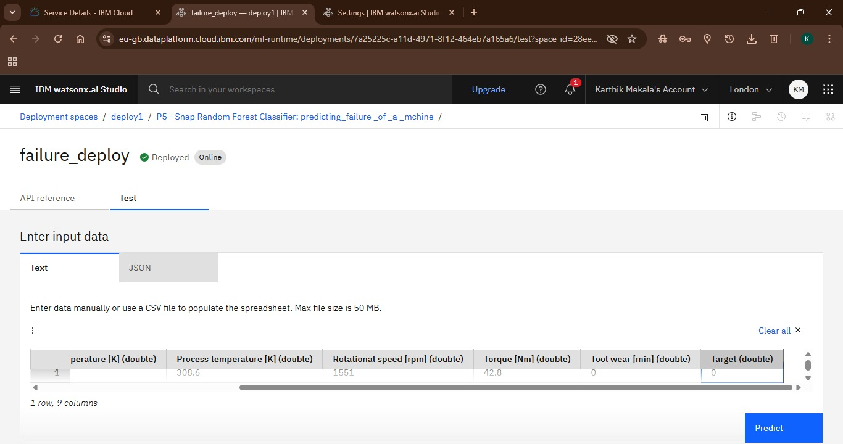

Slide 22
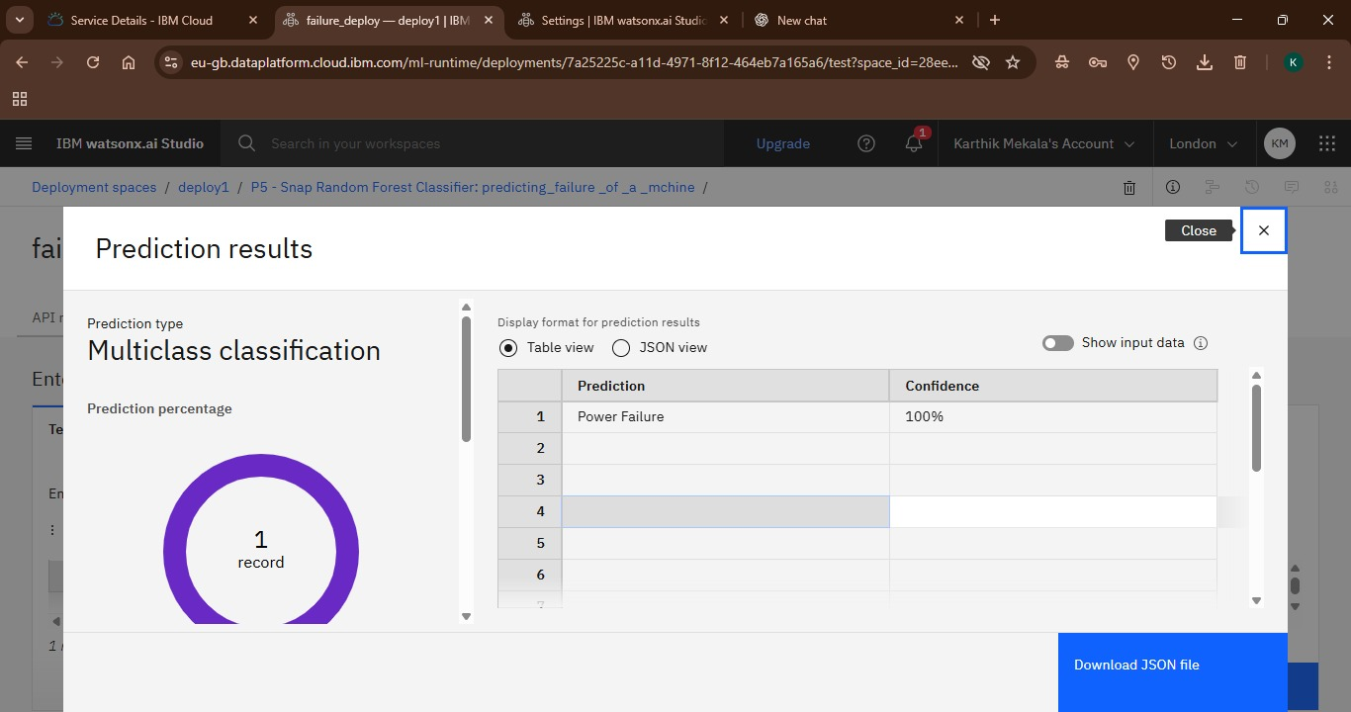

Slide 23
Conclusion
In conclusion, the predictive maintenance solution for industrial machinery, developed using IBM Watsonx.ai Studio on IBM Cloud Lite services, successfully addresses the challenge of anticipating equipment failures. By leveraging an advanced multiclass classification model (Batched Free Ensemble Classifier), the system achieves a remarkable accuracy of 0.995. The real-time online deployment of this model enables proactive maintenance decisions, which are crucial for minimizing downtime, reducing operational costs, and improving overall industrial efficiency. The project demonstrates the effectiveness of automated machine learning platforms in rapidly developing and deploying high-performance predictive solutions for complex industrial problems.

Slide 24
Future scope
Integration with CMMS: The model could be integrated with a Computerized Maintenance Management System (CMMS) to automatically generate maintenance work orders when a high probability of failure is predicted.
Real-time Dashboard: A real-time monitoring dashboard could be developed to visualize sensor data, model predictions, and alerts, providing a comprehensive overview of the fleet's health.
Prescriptive Maintenance: The solution could be enhanced to not only predict failures but also recommend specific maintenance actions to prevent them, moving from predictive to prescriptive maintenance.
Continuous Improvement: A feedback loop could be implemented to automatically retrain the model with new failure data, ensuring the model's accuracy continuously improves over time.

Slide 25
References
Kaggle Dataset: Shivam. (n.d.). Machine Predictive Maintenance Classification. Retrieved from https://www.kaggle.com/datasets/shivamb/machine-predictive-maintenance-classification
IBM Cloud: IBM. (n.d.). IBM Cloud Lite. Retrieved from https://www.ibm.com/cloud/lite
IBM watsonx.ai Studio: IBM. (n.d.). watsonx.ai Studio. Retrieved from https://www.ibm.com/products/watsonx-ai

Slide 26
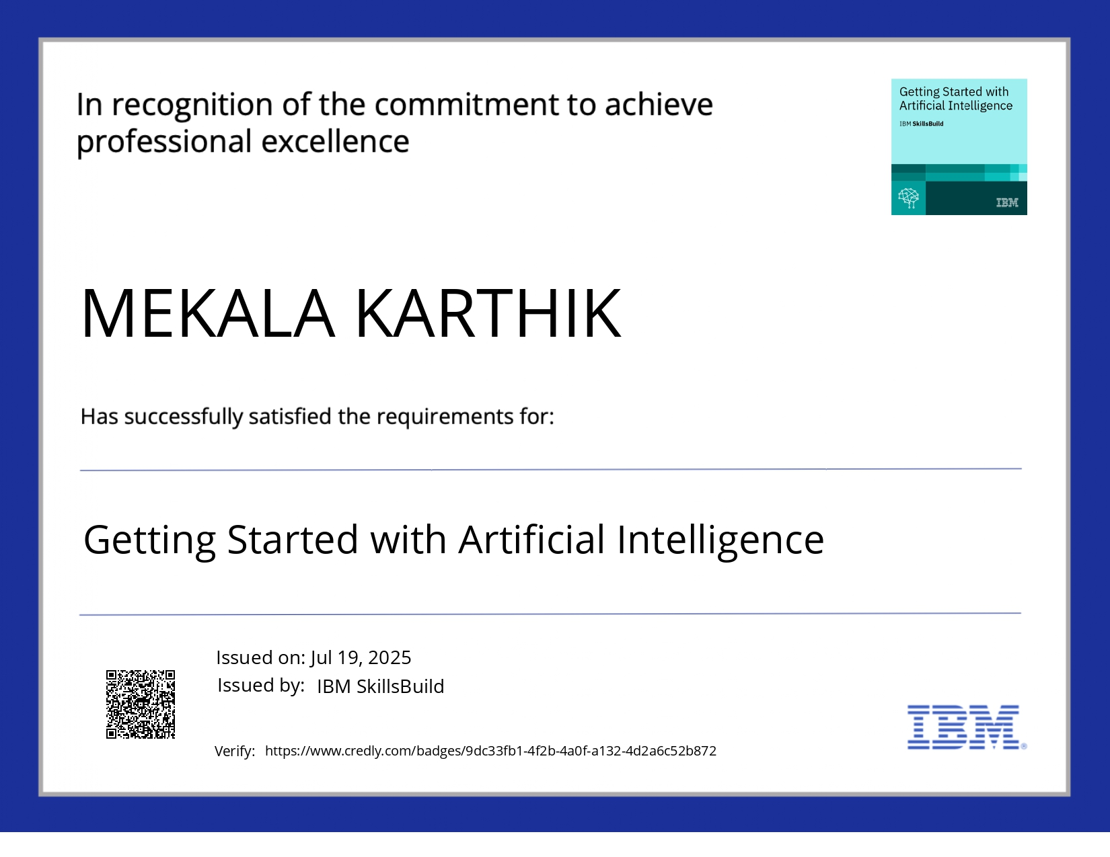
IBM Certifications

Slide 27
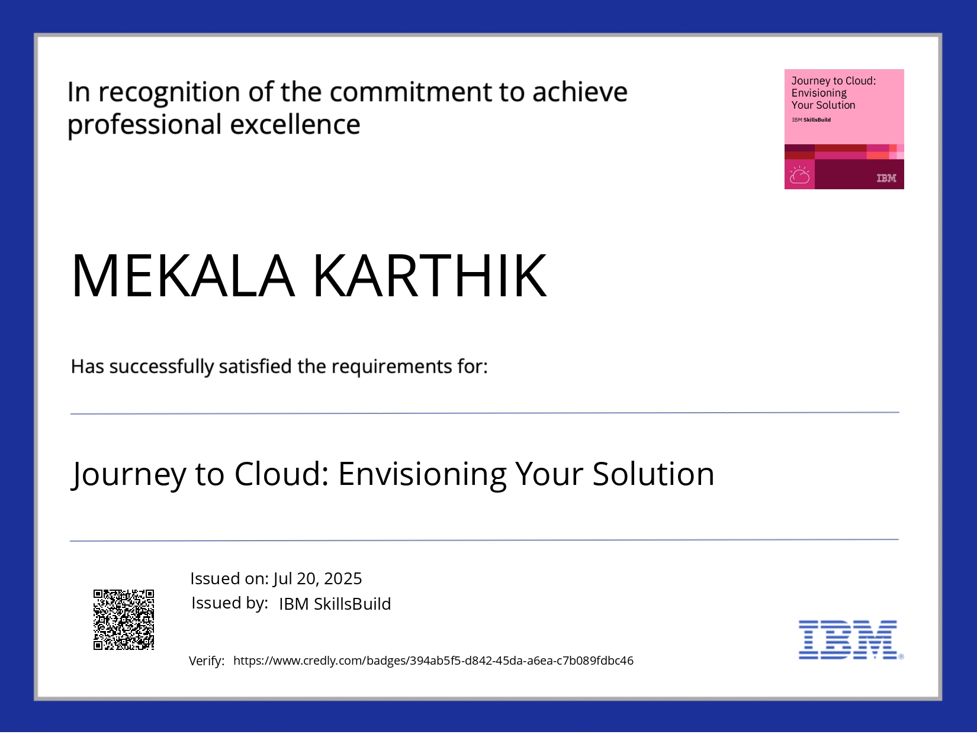
IBM Certifications

Slide 28
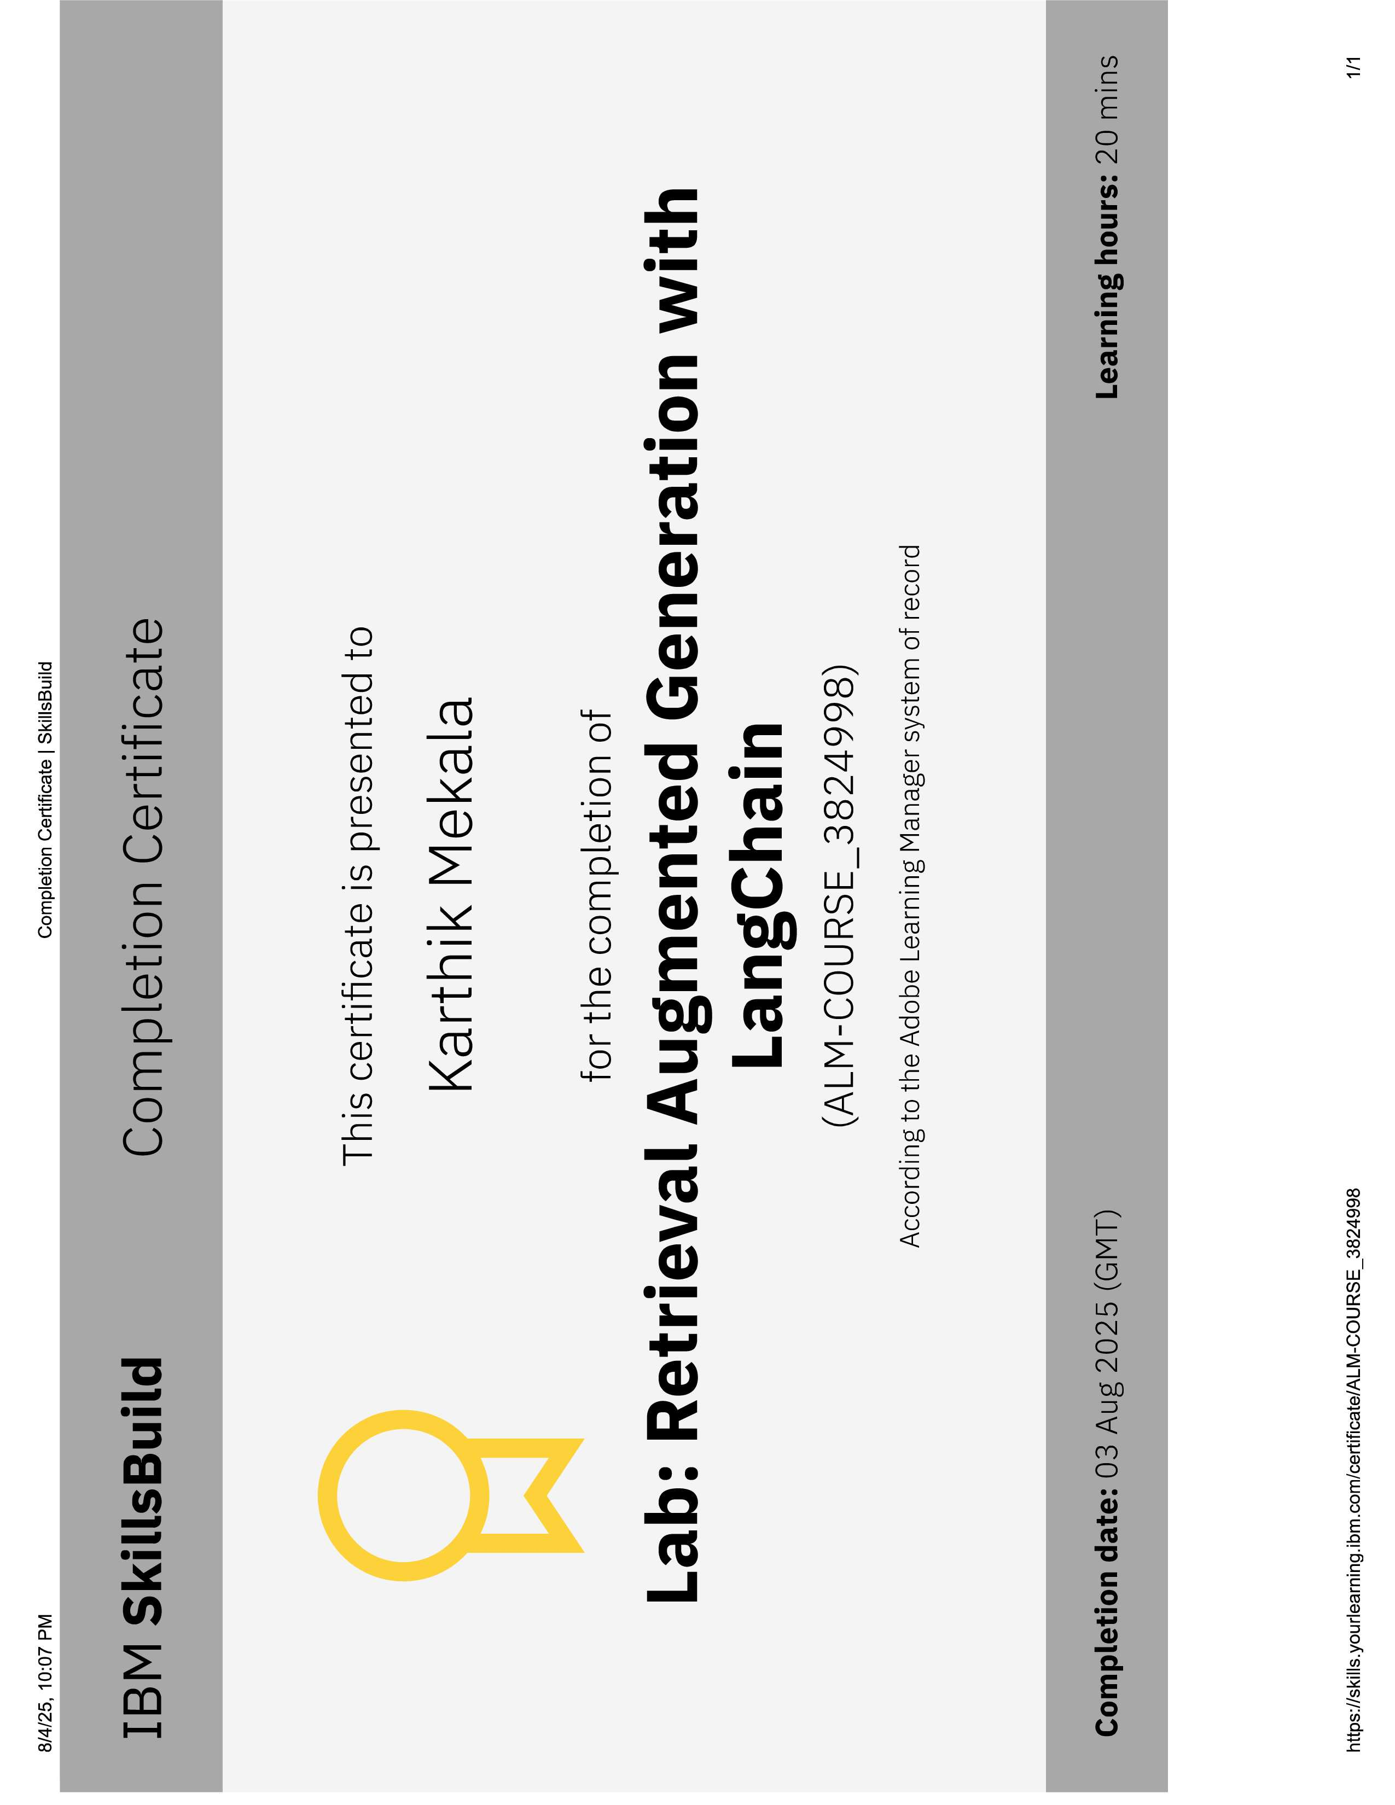
IBM Certifications

Slide 29
THANK YOU

